Slide 1


UNIVERSITY INSTITUTE OF ENGINEERING
COMPUTER SCIENCE ENGINEERING
Bachelor of Engineering (Computer Science & Engineering)
Subject Name: STATISTICAL METHODS USING R
Subject Code: 20SMT-460

Slide 2
Theory of Probability

Slide 3
In our day to day life, we sometimes make the statements: (i) It may rain today (ii) Train is likely to be late (iii) It is unlikely that bank made a mistake (iv) Chances are high that the prices of pulses will go down in next september (v) I doubt that he will win the race. and so on. The words may, likely, unlikely, chances, doubt etc. show that the event, we are talking about , is not certain to occur. It may or may not occur. Theory of probability is a branch of mathematics which has been developed to deal with situations involving uncertainty. The theory had its beginning in the 16th century. It originated in the games of chance such as throwing of dice and now probability is used extensively in biology, economics, genetics, physics, sociology etc.

Slide 4
Given below are the various terminologies used in probability:
Event: An event is a conclusion or outcome of an experiment.
Sample space: It denotes all the possible outcomes or events.
Mutually exclusive events: All the possible events of an experiment that cannot occur simultaneously or together.
Not mutually exclusive or Mutually exhaustive events: It represents all those possible events that can happen simultaneously.
Independent events: Independent events don’t rely on the occurrence of other events.

Slide 5
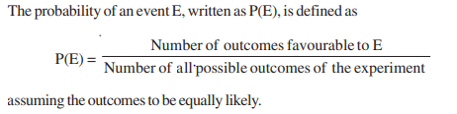

Slide 6
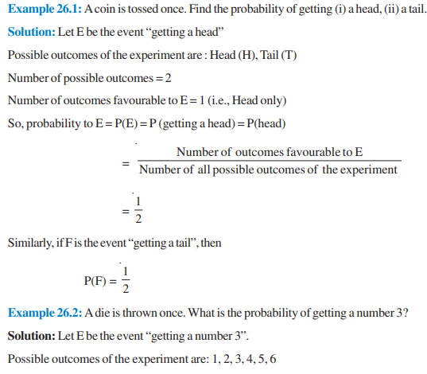
Examples:

Slide 7
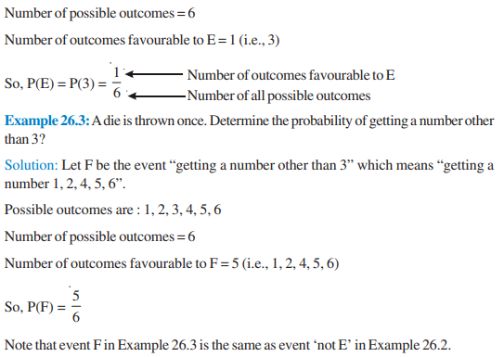

Slide 8
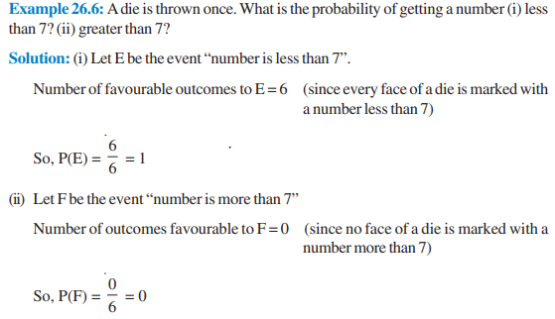

Slide 9
https://www.youtube.com/watch?v=mrCrjeqJv6U&list=PLbMVogVj5nJQWowhOG0-K-yI-bwRRmm3C&index=1&pp=iAQB

